Slide 1
Executive briefing
An introduction to Deep Secure
11th April 2018

Slide 2
Overview
In December 2016, we made a significant breakthrough in the field of cybersecurity by addressing a gap in the market for being able to simultaneously defeat all content threats – known, unknown/zero-day, and undetectable - without the need to understand or identify the threats and without isolating the business from them. Thus moving content security beyond detection.
We pioneered a disruptive technology that delivers absolute Digital Purity – threat-free content every time. We call this ‘Content Threat Removal’ (CTR), and it works by extracting the useful business information from the source data and constructing new, clean data to carry the information to its destination.
CTR defeats content weaponization entirely; evasion is not possible, now or in the future.
The efficacy of our CTR solution is unrivalled. We have the only viable approach to defeating sophisticated and undetectable threats such as Fileless, Next Gen Morphic, and Stegware.
CTR changes the economics of cybersecurity forever; we have re-priced cyber risk in the market.
The CTR platform can be deployed on premise, in the cloud, or as a hybrid solution. CTR is universally applicable to structured and unstructured data types and formats. CTR can be applied in a corporate enterprise context or in small form factors such as Industrial Control Systems & IoT.
Our hypothesis is that ‘Content is King’, and the winners in our emerging digital society will be those that can fully engage content head-on and leverage the power of transacting it, sharing it, and browsing it. CTR provides digital purity to fully enable the new technology revolution.
Our company is backed by British private equity house, Yorkshire Fund Managers, whilst our board is chaired by Richard Beaton and advised by former GCHQ Deputy Director Andrew France OBE.

Slide 3
Beyond detection – a race to digital purity
Gartner: Move beyond detection. Content Transforms needed to allow threat-free content to flow to the endpoint.
DIGITALLY PURE
Content Threat Removal
Removers
Ahead of the game and always will be
Information extracted from source data and delivered on completely new data for comprehensive Content Transforms.
No Evasion - No Fail - No Loss.
Browser Isolation
Isolators
Policy exceptions essential to get job done
Isolates system from unsafe content.
Reduces SOC alerts by circa 60%.
Isolates safe content as well.
Exceptions to isolation policy essential to get job done.
Exploited by sophisticated attackers.
Detectors
Traditional Security Stack
Trivially evaded by smarter attackers
Signature-based Anti-Virus, NGFW, SWG, Sandboxing, DLP, CDR, & EDR.
Volume of SOC alerts a big headache.
BEST ENDEAVORS
Efficacy of Threat Protection
We are on the brink of a technology revolution that requires digital purity at its very foundation
Notes:
Introduce the team – I have worked with them all prior to Deep Secure.
Every now and again we have a really significant technology breakthrough in the world, and in December 2016 we think we made one at Deep Secure. We pioneered a technique to deliver absolute digital purity – threat-free content every time. We worked out how we could simultaneously defeat - known, unknown (zero-day), and the undetectable - content threats.
Whilst we can all see the immediate significance in our field of cybersecurity, we think this is a foundational technology for all of the emerging mega-trends in the upcoming technology revolution such as AI/ML, autonomous systems, the multi-cloud economy, digital content, and IoT.
In cybersecurity we are already beginning to see a move in the strategic architectures. The failure of the Detectors and the overloading of the IT HDs and SoCs, has led to the evolution of the Isolators to help hold the threat at arms length, but the winners in our digitally transformed economy will those that can engage content head-on, and that’s where we come in – we do the last mile of cybersecurity – threat-free content every time.

Slide 4
Content Transform approaches
Good
Information Extraction approach to Content Transforms needed to move beyond detection.
Information Extraction overcomes flaws in Content Disarm & Reconstruction.
The only safe way to defeat Stegware, next gen Polymorphic, and Fileless threats.
Native content transforms for pixel perfect user experience.
Resampling
Information Extraction
Content Disarm & Reconstruction
Usability
Path to Digital Purity
Flattening
Poor
Low
Efficacy
High

Slide 5
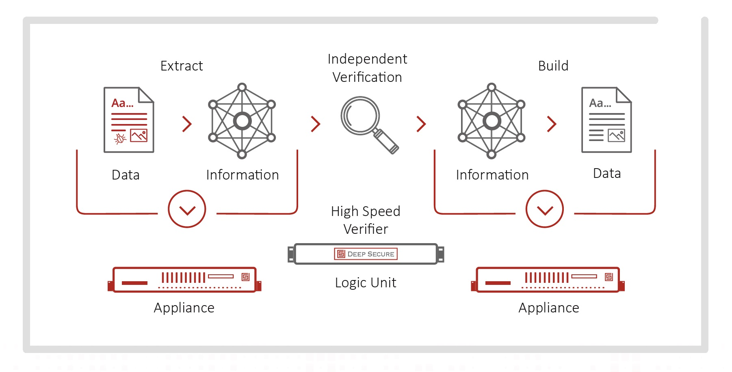
Content Transforms through Information Extraction
Extract permitted business information, verify it is safe, create a safe format for delivery
Separation of extract and build processes with hardware allows for ultra-high assurance deployments
Content Transforms
Notes:
Network layer attacks are completely prevented – which means that you cannot bypass the content transform process
By separating the parsing and rendering processes to either side of the protocol break boundary the hardware verification layer can ensure the rendering process only has to handle data that is safe
The renderer is protected from attack by the early security enforcing functions and protects the endpoint applications from attack by being restricted to only producing safe data for them to handle. This is possible because the renderer only needs to know a single safe data format per data type delivered (as opposed to identifying safe formats for the myriad of construction mechanisms for the different types of data being delivered to the endpoint e.g. PDF).
The reason this is the only viable way moving forward is:
Polymorph
Steganography

Slide 6
Extensive use cases
Content Threat Removal
Structured Information
Web services, XML, JSON
IoT, Application Delivery Networking
Machine to Machine
User to Machine
Structured or unstructured Information
PDF, OfficeX etc.
Citizen Portal, Managed File Transfer
Steganography
User to User
Business Information
PDF, OfficeX etc., Email, Browse, File Transfer, Chat & Collaboration
Defeats all content threats -known, unknown/zero-day, and the undetectable (Stegware) – delivering digital purity
Notes:
Content Threat Removal works across many use cases and can be employed in multiple roles, enabling clean secure zones and clean secure feeds (pipes)

Slide 7
We have pioneered a technique that delivers full content transforms both inbound and outbound to simultaneously defeat all content threats
Moving cybersecurity beyond detection
We future proof security because we don’t need to distinguish between good and bad data.
Our high-speed hardware verifier has zero attack surface.
Defeats Fileless, Stegware, and Next Gen Morphic content threats.
The economics of cybersecurity have been changed forever.
Our content threat removal platform assumes all source data is bad and none is allowed to cross the boundary.
It works by extracting useful business information, discarding the source data, before constructing new clean data to carry the information to its destination.
Content threat removal delivers native content transforms; we do not conduct partial content transforms like content disarm & reconstruction as this approach is fundamentally flawed.
We deliver full feature, pixel perfect documents - not facsimiles.
CTR provides digital purity: data only carrying relevant business information. Specifically, data not in any way dangerous, and data not carrying irrelevant information.
Notes:
Simon to add notes ….

Slide 8
  Deep Secure Limited
  1 Nimrod House, Sandy’s Road
  Malvern, Worcestershire, WR14 1JJ
  United Kingdom
  Deep Secure Limited
  131 Finsbury Pavement,
  London, EC2A 1NT
  United Kingdom
www.deep-secure.com

